Slide 1


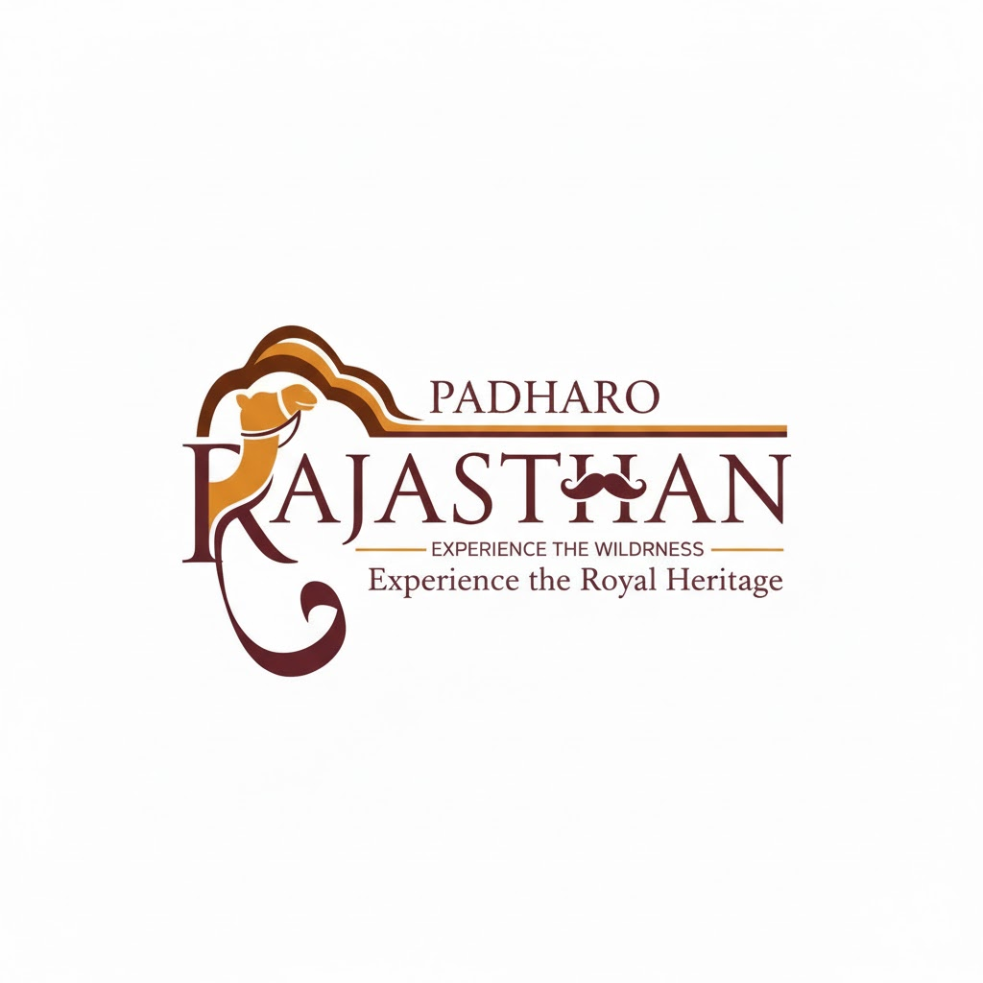
THE EXCALIBUR HACKATHON
PADHARO - Smart Tourism Companion for Rajasthan
Revolutionizing tourism through AI-powered personalized travel experiences across the vibrant landscape of Rajasthan
by Navya Yukti Team
Hackathon Project Presentation

Slide 2


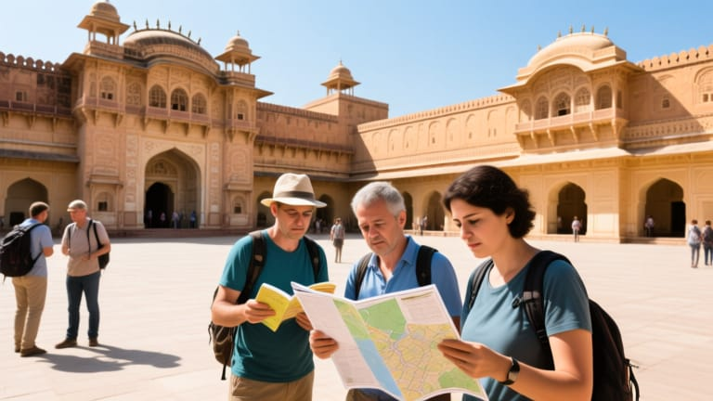
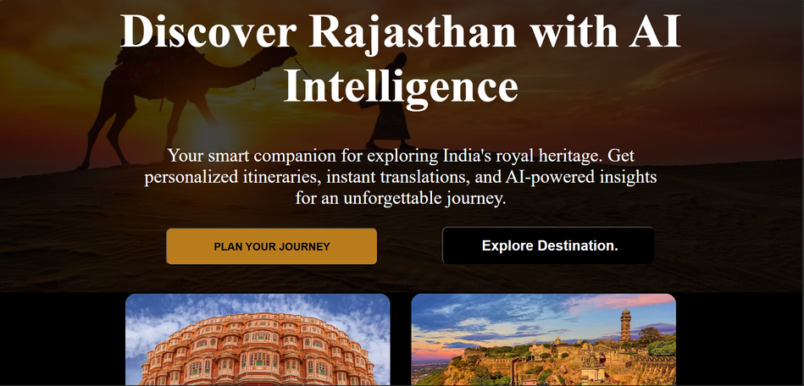
PROBLEM STATEMENT
TOURIST CHALLENGES
Visitors to Rajasthan face significant hurdles including inefficient trip planning, language barriers, and lack of authentic local insights that prevent them from experiencing the true cultural richness of the region .
TRIP PLANNING ISSUES
Complex logistics and limited personalized recommendations lead to suboptimal travel experiences
COMMUNICATION BARRIERS
Language gaps prevent meaningful interactions with locals and cultural immersion .

Slide 3

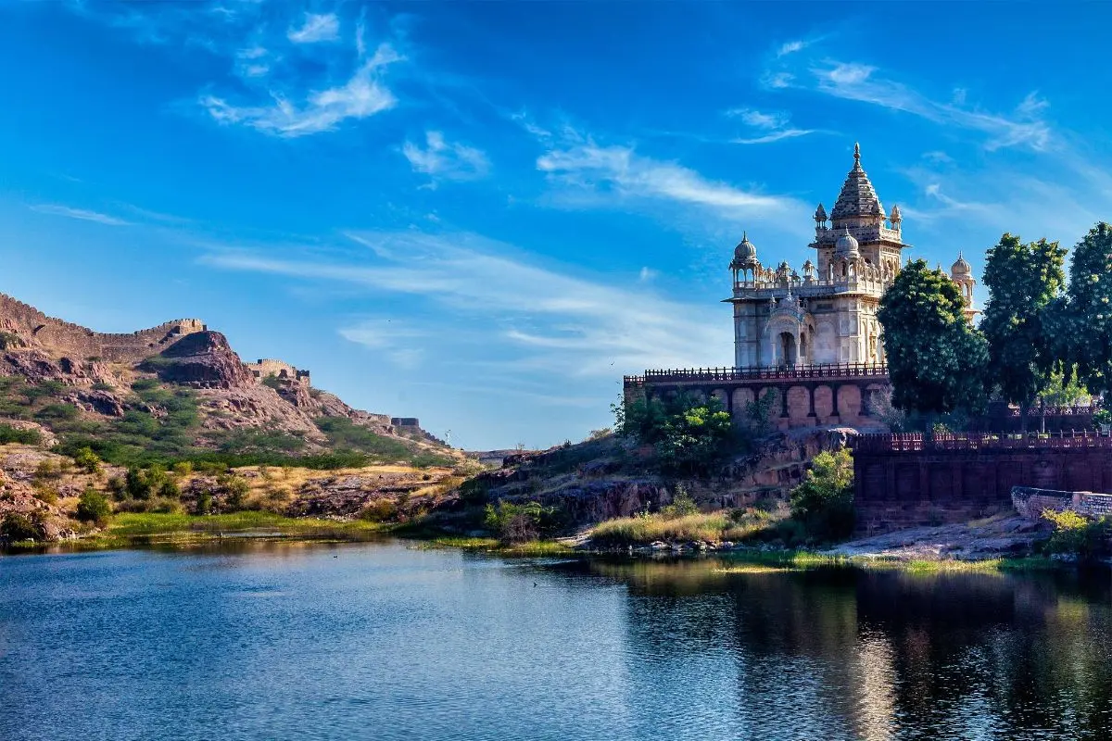



SOLUTION OVERVIEW
MULTILINGUAL AI TOUR GUIDE
Real-time translation and AR-powered monument narration in multiple languages include Hindi, Rajasthani, English, French, and Spanish.
PERSONALIZED ITINERARY GENERATOR
AI-powered trip planning that creates optimized day-wise schedules based on budget,duration, and personal interests with real-time Google Maps integration.
TOURISM INSIGHTS DASHBOARD
Advanced analytics platform providing sentiment analysis and trend identification from social media and tourist reviews .

Slide 4
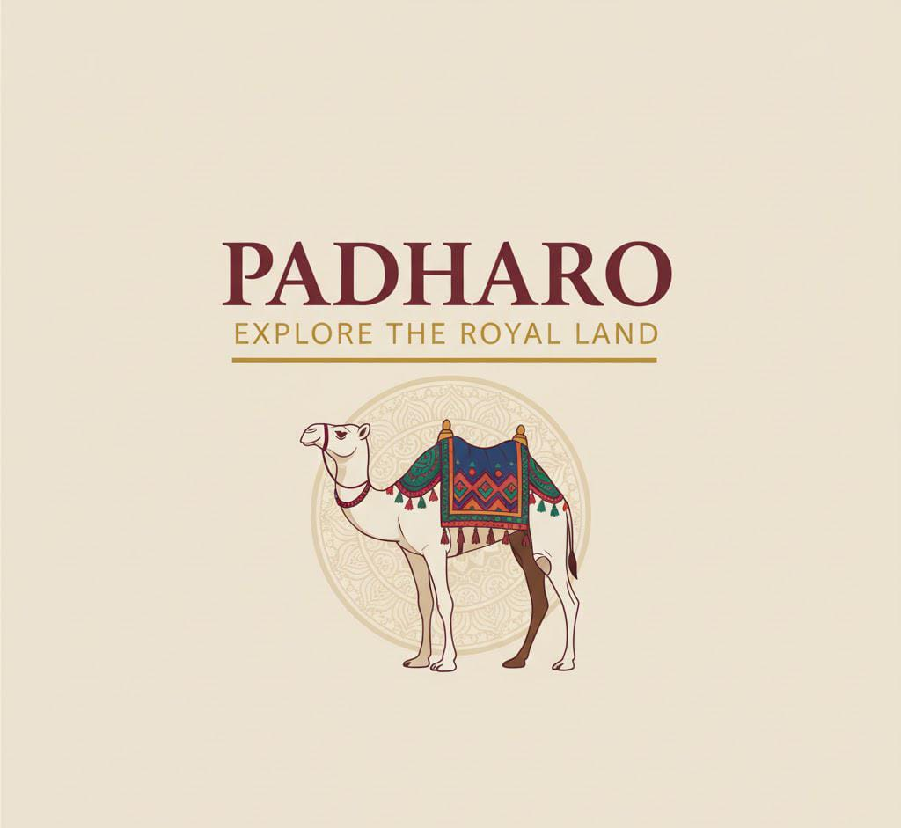






Goal # 1
Personalized Experiences
Create on AI-powered platform that tailors every aspect of the Rajasthan tourism experience to individual preferences and interests .
Goal # 2
OUR OBJECTIVES
Inclusive Tourism
Break down language and accessibility barriers to make Rajasthan’s cultural heritage available to all visitors.
Goal # 3
Data-Driven Insights
Transform tourism data into actionable intelligence for continuous improvement and sustainable growth.

Slide 5

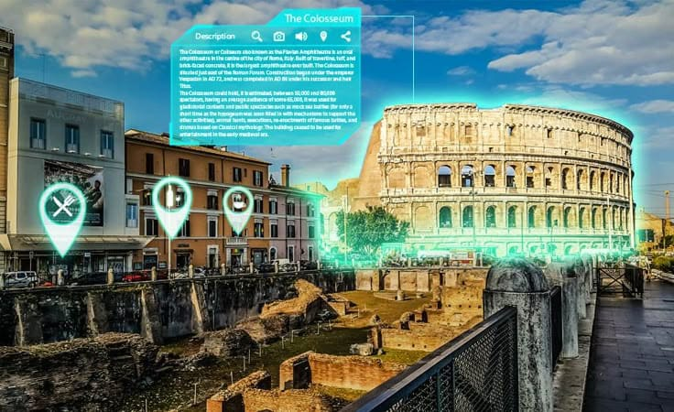
Feature 1: Personalized AI Itinerary
Intelligent Preference Analysis
Advanced AI algorithms analyze tourist preferences including budget constraints, travel duration, and personal interests to create perfectly tailored experiences.
Optimized Route Planning
Generates efficient day-wise travel plans with integrated Google Maps for seamless navigation and time optimization.

Slide 6
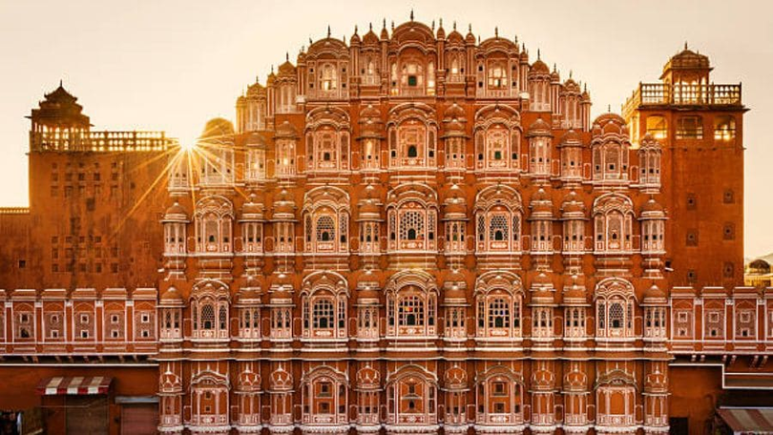

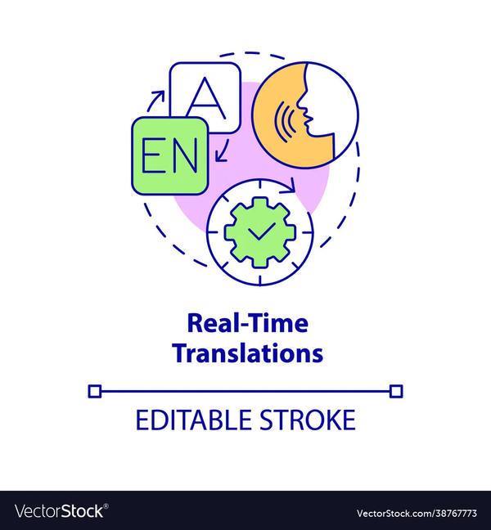
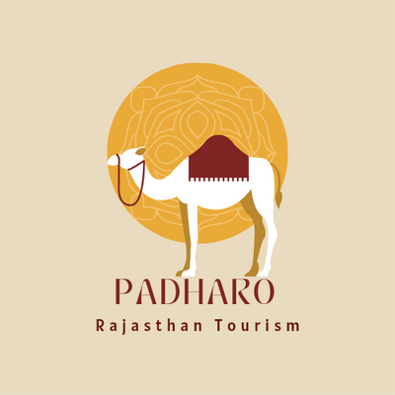

Feature 2 : Multilingual AI Guide
AR Monument Scanning
Point camera at monuments for instant AI narration.
Historical facts and cultural stories in native language.
Interactive 3D models and reconstructions.
Real-Time Translation
Instant translation between Hindi / Rajasthani and English / French / Spanish.
Voice and text translation for seamless communication.
Offline capability for remote locations.

Slide 7
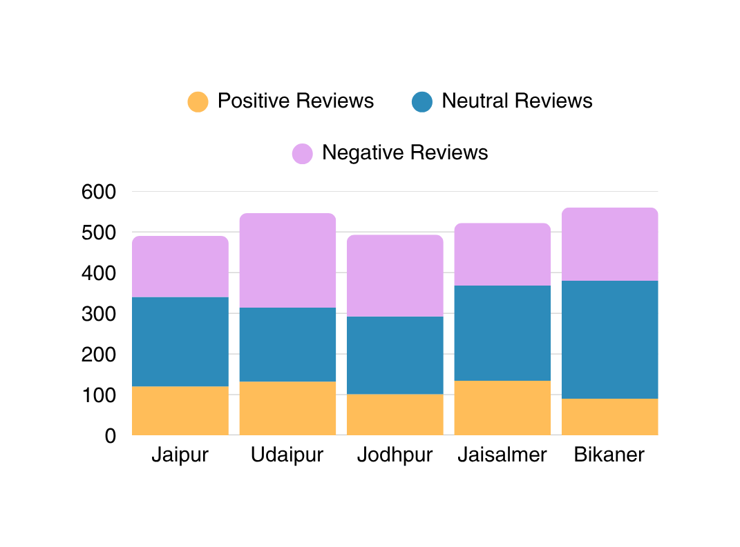
Feature 3 : AI Insights Dashboard
Tourism Analytics Overview
Smart Analytics Features
Our AI-powered dashboard processes thousands of social media posts and reviews to provide real-time insights into tourist sentiment, emerging trends, and areas needing improvement across Rajasthan’s tourism ecosystem.
Sentiment analysis from multiple social media platforms.
Identification of trending destinations and experiences.
Early warning system for potential tourism issues.

Slide 8





TECHNICAL ARCHITECTURE
Frontend Solutions
Flutter and React Native for cross platform mobile applications ensuring seamless user experience across iOS and Android devices.
Backend Infrastructure
Python FastAPI powering robust backend sevices with high-perfomance REST APIs and microservices architecture.
Analytics Dashboard
Streamlit and Tableau integration for comprehensive data visualization and business intelligence reporting.
AI/ML Integration
OpenAI API and huggingFace models for natural language processing, translation, and recommedation systems.

Slide 9
IMPACTS AND BENIFITS
85%
Tourist satisfaction
40%
Local Business Growth
60%
Efficiency Gain
30%
Revenue Increase
For TouristS
Personalized itineraries, language barriers removed,
authentic local experiences.
Smart personalized travel planning
Multilingual support for seamless communication
Access to hidden gems and authentic experience.
FOR LOCALS
Increased visibilty for small businesses and preservation of cultural heritage.
Promotion of local businesses and artisans
Preservation of cultural traditions
New economic oppurtinities
FOR GOVERNMENT
Data-driven policy making and improved tourism infrastructure planning
Real-time tourism analytics and insights
Evidence-based policy decisions
Improved resource allocation

Slide 10



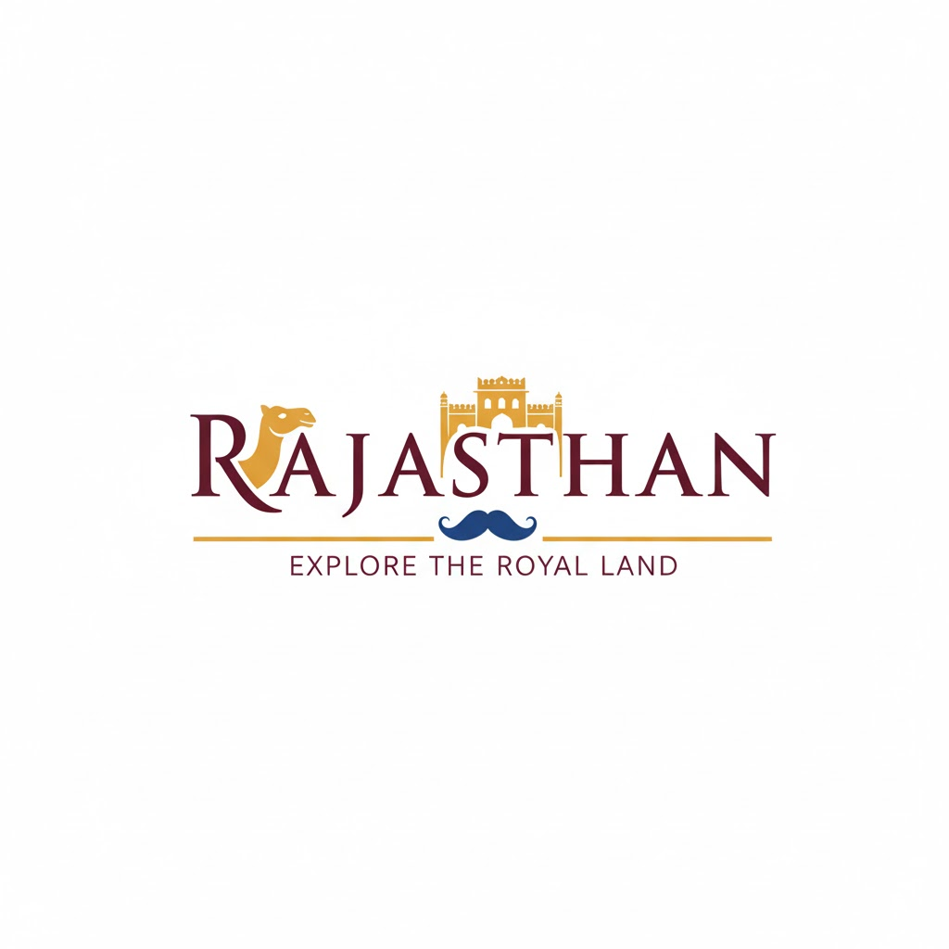
Future Scope
AR /VR Heritage Experiences
Government Integration
immersive virtual reality tours of historical sites and augmented reality reconstructions of ancient Rajasthan
Direct API integration with Rajathan Tourism Department for real-time data sharing and official partnership.
Pan-India Expansion
scale the platform to cover other Indian states and create a unified smart tourism ecosystem.

